Slide 1
UNIVERSAL POWER TOOL TO BE USED AS A SCREWDRIVER, WRENCH, DRILL FOR HOUSEHOLD.
ME 322 Project
- Team ‘BETA’

Slide 2
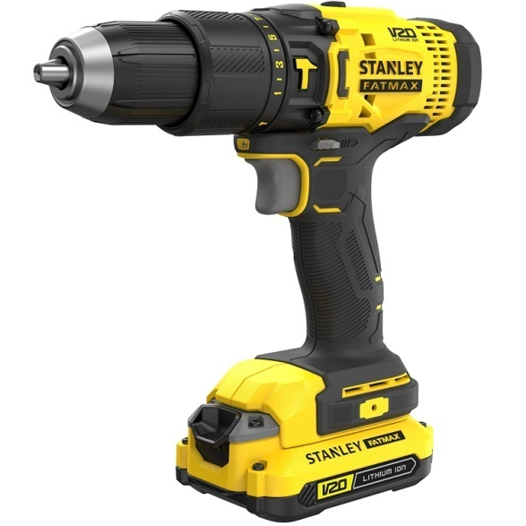
INTRODUCTION:
What is a Universal power tool ?
A Universal power tool is technically a power driven hand tool and a portable one. The main part of universal power tool is universal motor due to it’s high starting torque.

Slide 3
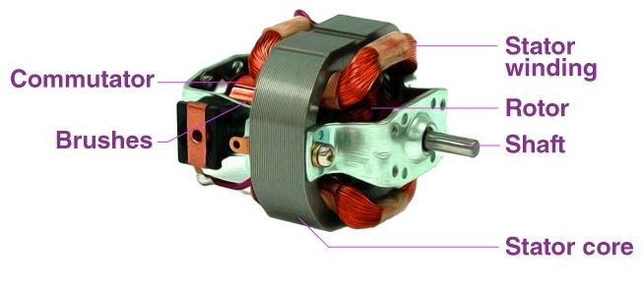
Universal Motor:
A universal motor is type of motor which runs on both AC and DC power supplies. Regardless of AC or DC supply, universal motors work on the same principle that DC series motors work on.

Slide 4
PROBLEM FORMULATION:
Operations like drilling, wrenching, screwdriving can be performed by respective individual tools i.e, power drill, impact wrench, power screwdriver. The motive is to accumulate all the functions in one tool for household purpose, to make it accessible to everyone in one tool.
Drilling, Wrenching, Hammering, Screwdriving operations should be carried out in a single power tool just by switching the orientation and combinations of the gears, shafts and electric circuits in power tool.

Slide 5
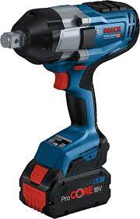
MARKET SURVEY:
In general impact wrench, electrical screwdriver and drilling machines are available in market individually and at high power for their respective needs but for the household needs we don’t require the amount of power that the commercial power tools are offering even with less power small household operations can be carried out.
Impact wrench of power 1050W
(price range 10k - 15k)

Slide 6
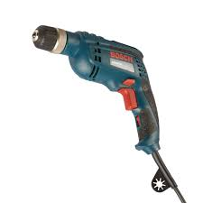
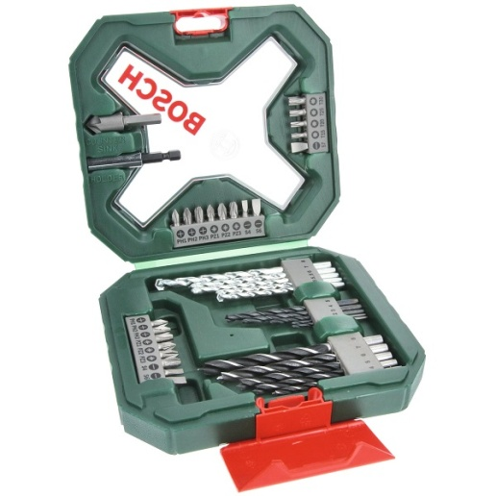
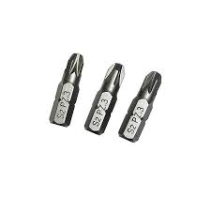
MARKET SURVEY:
Corded power drill
Drill bits used for power drill
Screwdriver bits
We are thinking of developing a single power tool for which the power output is low which is enough for the small household needs and to avoid the purchase of multiple high power, power tools.

Slide 7
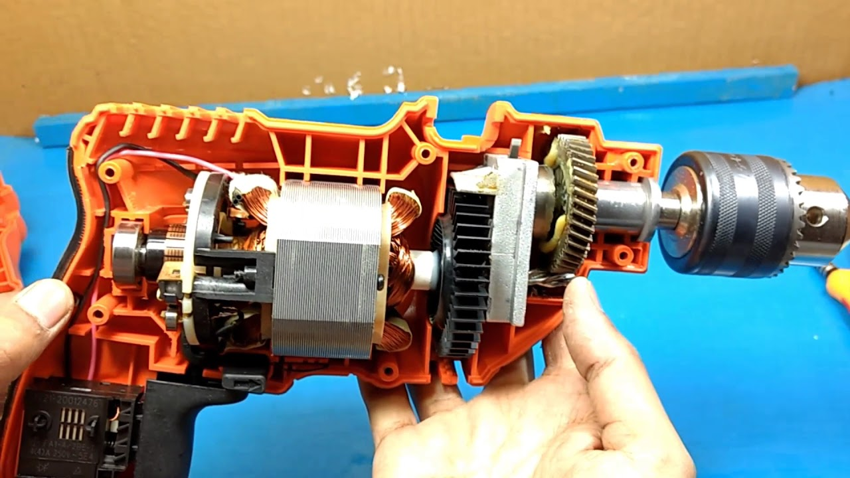
Idea for the solution:
The main motive is to accumulate these requirements in a single power tool .
The cross-section of the tool used for high power drilling and screwdriving is shown below.

Slide 8
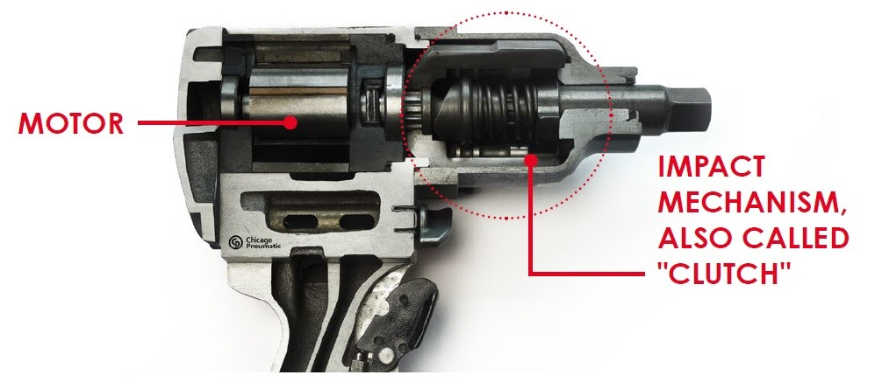
Idea for the solution:
The cross-section of the tool used for impact wrenching is shown below

Slide 9
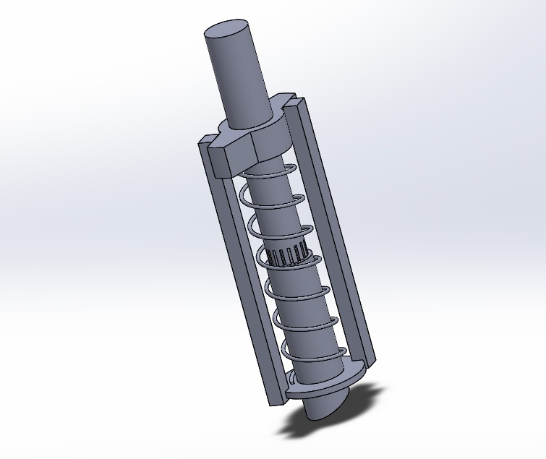
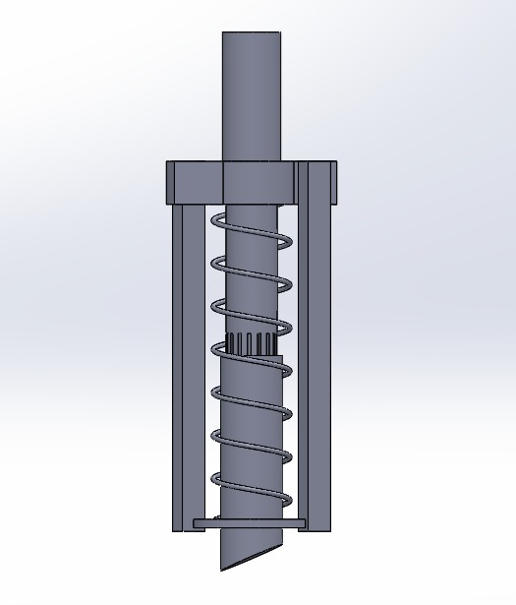
CAD model of mechanism (clutch) of an impact wrench

Slide 10
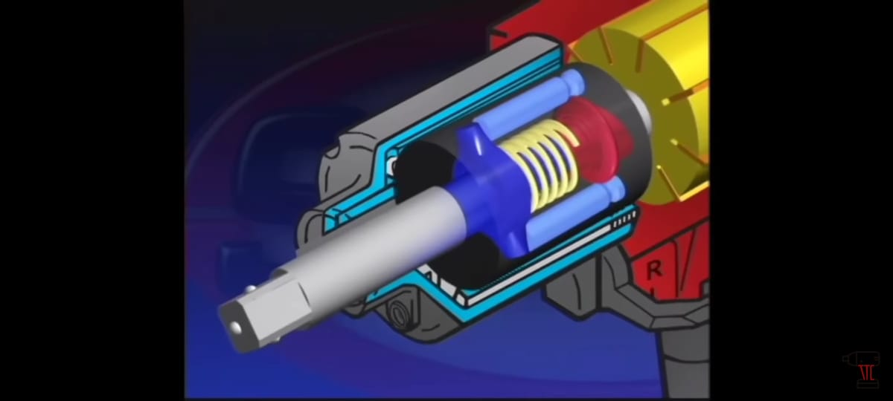
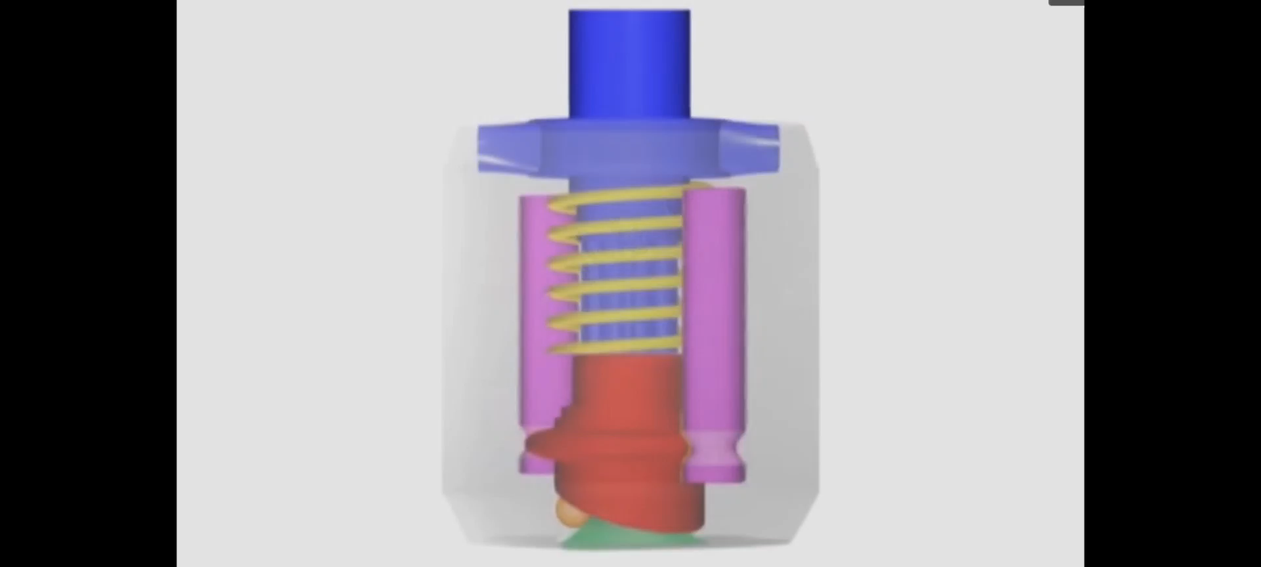
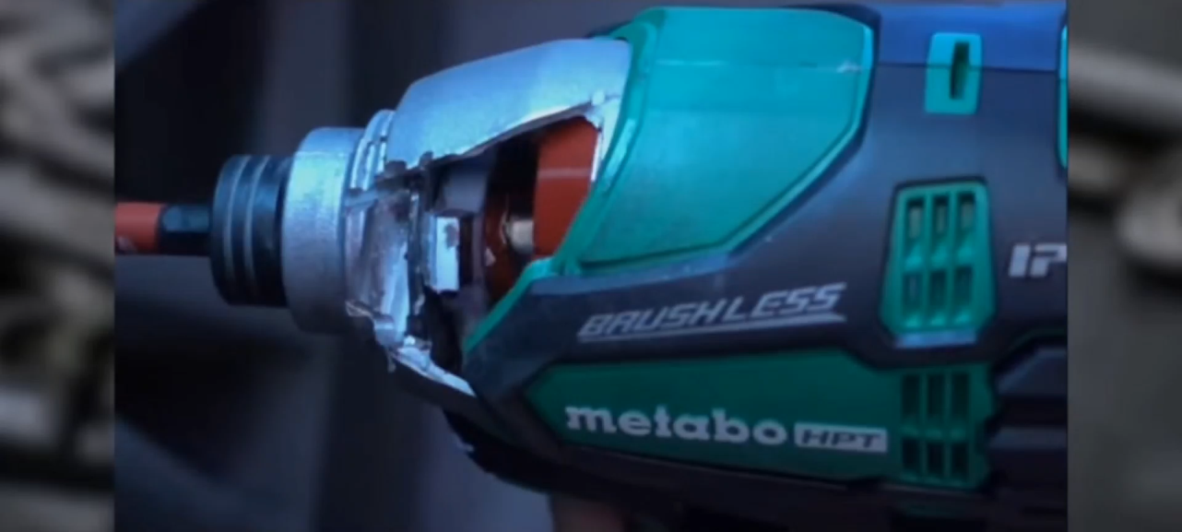
Cross-section of impact wrench
Clutch mechanism
Working of an impact wrench

Slide 11
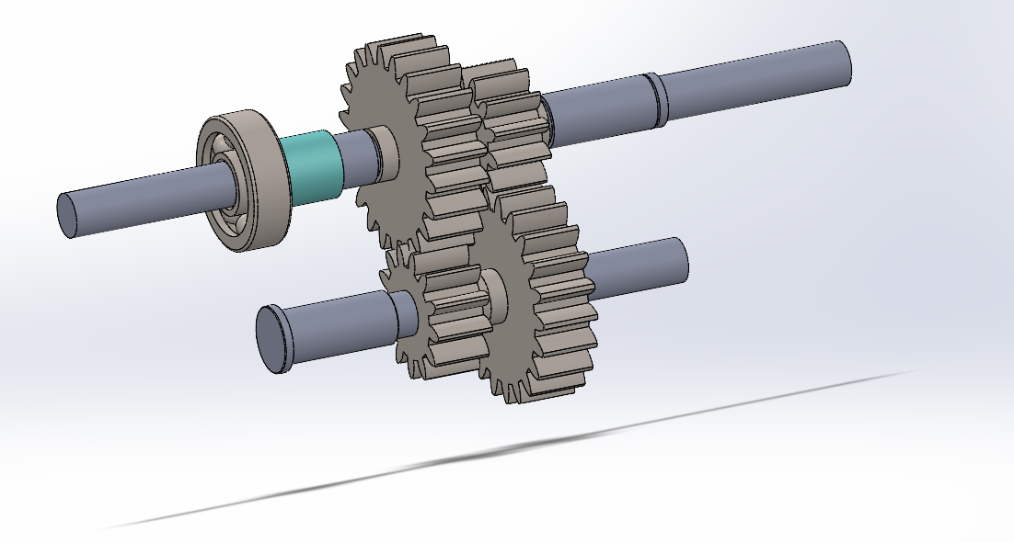
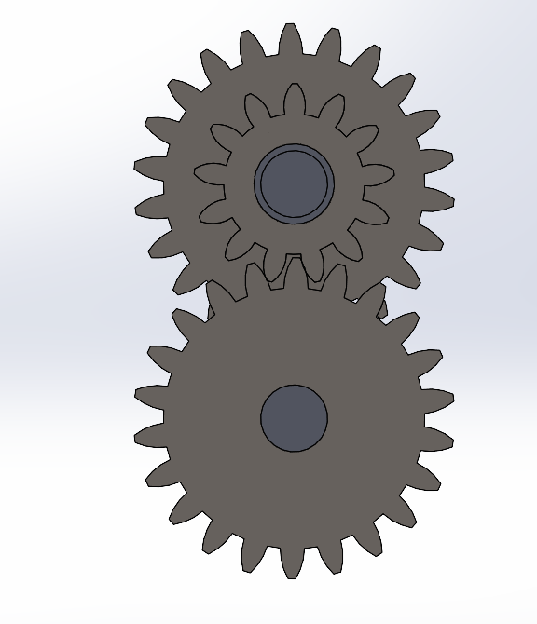
CAD Model of Internal Mechanism:

Slide 12
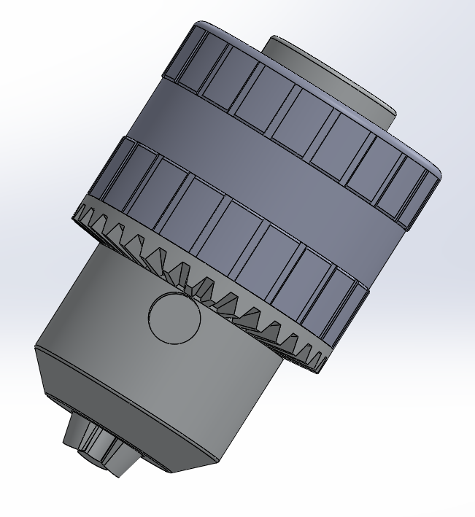
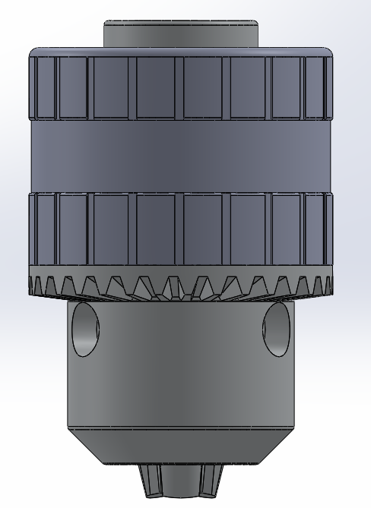
CAD Model of Chuck:

Slide 13
Idea for the solution:
Universal Motor
Gear Box
Chuck
Power Supply
Required Action

Slide 14
Idea for the solution:
At the front of the tool, there would be a chuck mechanism for holding interchangeable attachments, such as a screwdriver bit, a wrench adapter and a drill bit. The chuck would be easily adjustable to switch between attachments, with a simple mechanism to lock and release the bits.
The tool would also feature a variable speed control, located on the body of the tool, allowing the user to adjust the speed to suit the task at hand.
The chuck mechanism is a key component of a multi-tool that allows for the attachment of different tools and accessories. A chuck consists of three jaws that are evenly spaced. The jaws are operated by a sleeve that can be rotated to tighten or loosen the grip on the tool or accessory being held.
A variable speed control allows the user to adjust the speed of the tool depending on the task at hand, making it easier to handle different materials and achieve greater precision.
By varying the voltage supplied to the universal motor, the speed can be controlled. Lowering the voltage will result in lower speed, while increasing the voltage will result in higher speed.

Slide 15
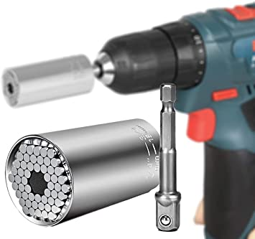
Idea for the solution:
For drilling and screw driving action, we should attach either drill bit or screw driver bit to the chuck based on our need.
We should adjust the tool speed based on the type of the task.
A wrenching tool can't be directly attached to a keyless chuck since it requires a different mechanism to tighten or loosen bolts and nuts.
In order to perform wrenching action:
Wrenching tool
Socket adapter
Chuck

Slide 16
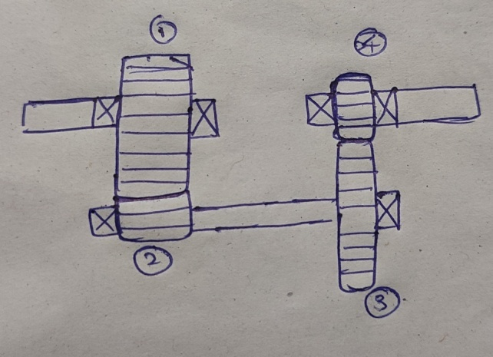
Dimensions of Gears and Gear Ratio:
Generally gear ratio for output to input will be in the range of 2 to 4.For household needs, we will design it in such a way that the gear ratio will be 2.50.
We must make sure that module of meshing gears should be same.
By looking at the figure, d1 + d2 = d3 + d4.
Velocity gain between 1 and 2 will be 2.00 and between 3 and 4 will be 1.25.
By satisfying all the above conditions, we get:
Diameter of gear 1 = 30mm. Number of teeth on gear 1 = 24.
Diameter of gear 2 = 15mm. Number of teeth on gear 1 = 12.
Diameter of gear 1 = 25mm. Number of teeth on gear 1 = 20.
Diameter of gear 1 = 20mm. Number of teeth on gear 1 = 16.

Slide 17
COST AND MATERIAL ANAYSIS:
The materials required are the following:
Gears - Carbon steel
Shaft and Socket adapter - Aluminium
Clutch Spring - Magnesium
Chuck - Carbon fibre
Material for outer casing
of power tool
Drill bits - High Speed Steel
Screw driver bits - High Carbon steel
Wrench - Stainless Steel
- Acrylonitrile Butadiene Styrene[ABS]

Slide 18
COST AND MATERIAL ANAYSIS:
S.NO | Component | Cost(Rs.)
1 | Gears | 1500
2 | Shaft | 200
3 | Universal Motor | 1600
4 | Chuck | 300
5 | Socket Adaptor | 500
6 | Outer Case | 500
7 | Screw driver , drill bits and wrench tool | 600
8 | Additional costs | 1000

Slide 19
COST AND MATERIAL ANAYSIS:
Total rough estimate cost of manufacturing =Cost(1+2+3+4+5+6+7+8 )
=1500+200+1600+300+500+500+600+1000
= 6200/-

Slide 20
Advantages:
Compact and light weight
Cost Effective
Portability
Time Saving
Flexibility
Space Saving

Slide 21
THANK YOU…
Sreeram Rohan – 200103076
Mergu Vishwaja – 200103077
Sweshik Nekkanti – 200103083
Sripathi Sriram - 200103108

